Slide 1

TOPIC 4:
FUNDAMENTAL OF PROJECT MANAGEMENT
PROJECT SIZE ESTIMATION – PLAN-DRIVEN AND AGILE-DRIVEN
Prepared by Dr Alif Ridzuan dan Dr Shahliza Abd Halim

Slide 2
LEARNING OUTCOME
Able to understand fundamental concept of project size estimation in software management.
Able to apply the concept of function point analysis (FPA) in plan-driven software project estimation.
Able to apply agile driven software estimation with Story Points and Velocity

Slide 3
So, what is Software Project Size Estimation?
It is a process of predicting effort, cost, time, and resources to complete a software project.
It helps with planning, scheduling, budgeting, risk management, and allocating resources efficiently.

Slide 4
PROJECT SIZE ESTIMATION
IN SOFTWARE MANAGAMENT

Slide 5
INTRODUCTION
In software project management, the project size is the most significant and important factors that influence effort, cost, and schedule.
Typically, the size of software project can be categorized into small, large and medium.
Small size project:
  Five or fewer total technical staff and the project duration is less than 3 months.
  Typically, can’t use the statistically oriented techniques that larger projects can use because variations in individual productivity drown out other factors.
  More likely to use a flat staffing model (using the same number of people on the team for the entire project), which invalidates some of the more algorithmically oriented large-project estimation approaches.
  The software project has low complexity.
  Low cost

Slide 6
INTRODUCTION
Large size project:
  Team of approximately 25 people or more that lasts 6 to 12 months or more.
  Requires organized task allocations and coordinated workflow due to large team members.
  Different members have specific roles and responsibilities. Sometimes assigned to different team or department.
  The software project has high complexity.
  High cost
Medium size project:
  Team of approximately 5 to 25 people that last 3 to 12 months.
  Have the advantage of being able to use virtually all the estimation techniques that large projects can use and several of the small-project techniques, too.
  The software project has medium complexity but can be scaled to low or high depending on the project characteristic and complexity.
  Cost depends on the project size scaling.
Thus, estimating the right size of the software project is necessary.

Slide 7
ADVANTAGES
Estimation is closer to the developer’s perspective.
Commonly used and become a practice in most organizations to manage software project.
Easily quantified upon project completion.
Supports better decision-making in software development.
Simple to use and implement.

Slide 8
DISADVANTAGES
Different programming languages contain a different number of lines and complexity.
No proper industry standard exists for this technique.
It is difficult to estimate the size using this technique in the early stages of the project.
When platforms and languages are different, difficult to normalize.

Slide 9
FUNCTION POINT ANALYSIS (FPA)
(Plan-Driven Estimation)

Slide 10
What is Function Point Analysis (FPA)?
FPA is a systematic approach to measure the different functionalities of a software application based on function point metrics.
FPA is used to estimate project effort, cost, and productivity by quantifying the functionalities delivered to the user.
FPA evaluate functionality from the perspective of the user, that is, based on the requests and responses they receive.
Technology independent: Measures the software based on functionality, not on the programming language or technology used.

Slide 11
Advantages of Function Point Analysis (FPA):
Technological Independence
  Calculates a software system’s functional size independent of the underlying technology or programming language used to implement it.
Better Accurate Project Estimation
  Improve project estimation accuracy by measuring user interactions and functional needs.
  Useful in long-term project estimation.
Improved Interaction
  Provides a common language for business analysts, developers, and project managers to communicate with one another and with other stakeholders.

Slide 12
Advantages of Function Point Analysis (FPA):
Making Well-Informed Decisions
  Assists in making well-informed decisions at every stage of the software development life cycle.
  FPA is a high-level estimation, thus useful for project manager to estimates the overall project effort, cost and time.
  Helps to make decisions about resource allocation, project prioritization, and technology selection.

Slide 13
Disadvantages of Function Point Analysis (FPA):
Subjective Judgement: FPA heavily relying on personal opinions and interpretations instead of just using clear, measurable standards.
Low Accuracy: Has low evaluation accuracy as it’s dependency on subjective judgement.
Time Consuming: FPA is time-consuming, particularly during the initial stages of implementation.

Slide 14
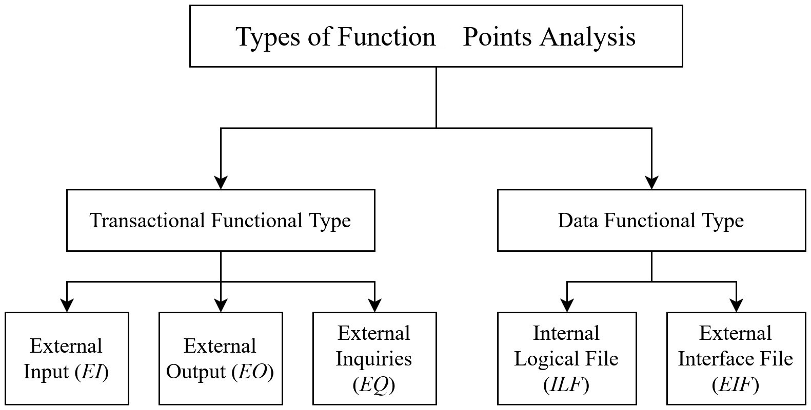
The components in FPA are categorized into two functional types:
FPA evaluate functionality from the perspective of the user, that is, based on the requests and responses they receive.
FPA count the number of different data structures that are used and assumed that the number of different data structures is a good size indicator.

Slide 15
Components in Function Point Analysis (FPA):
There are five components that play a central role in FPA:
Component | Description
External inputs (EI) | EI refer only to user input that results in changes in data structures. It does not concern user input which is solely concerned with controlling the program’s execution. Each input type that has a different format, or is treated differently, is counted. Though the records of a master file and those of a mutation file may have the same format, they are still counted separately. Example: A login form accepting username and password.
External outputs (EO) | EO generates data or control information sent outside the application’s boundary. Example: Invoice report etc.

Slide 16
Component | Description
External inquiry (EQ) | EQ concern on input that controls the execution of the program and does not change internal data structures. Examples: Menu selection, query criteria or searching for a customer in a database.
Internal logical files (ILF) | This concerns internal data generated by the system, and used and maintained by the system, such as, for example, an index file or database records. Example: A database table storing employee records.
External Interface File (EIF) | This concerns data that is output to another application or is shared with some other application. Example: A product list imported from an external system.

Slide 17
In Function Point Analysis (FPA), there is a standard complexity weights table used as reference when determining FPA component complexity:
Component | Complexity Weight
 | Low | Average | High
EI | 3 | 4 | 6
EO | 4 | 5 | 7
EQ | 3 | 4 | 6
ILF | 7 | 10 | 15
EIF | 5 | 7 | 10

Slide 18
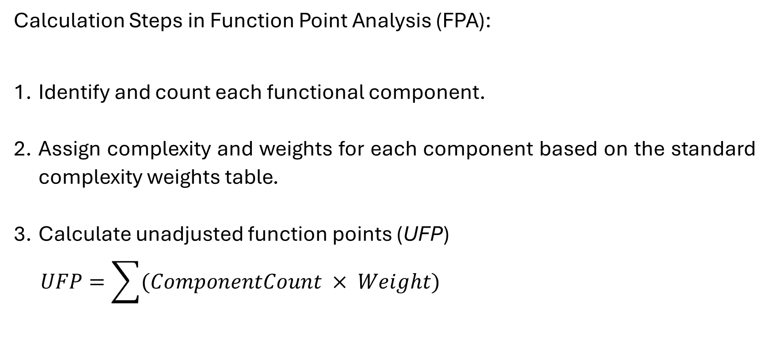

Slide 19
Apply value adjustment factor (VAF)
4.1 Estimates total degree of influence (TDI) based on 14 general system characteristics (GSCs) which rate the general functionality of the software being measured:
    Data communication.
    Distributed data processing.
    Performance (response time).
    Heavily used configuration.
    Transaction rate (peak transaction period monthly, weekly, daily, etc.).
    On-line data entry (what percent of total application development is data entry screens).
    End user efficiency (degree of user friendliness provided in the application).
    On-line update.
    Complex processing (degree of mathematical and logical processing).
    Reusability (What percent of code is reusable).
    Installation ease.
    Operational ease.
    Multiple sites.
    Facilitate change (flexible queries and report facilities).

Slide 20
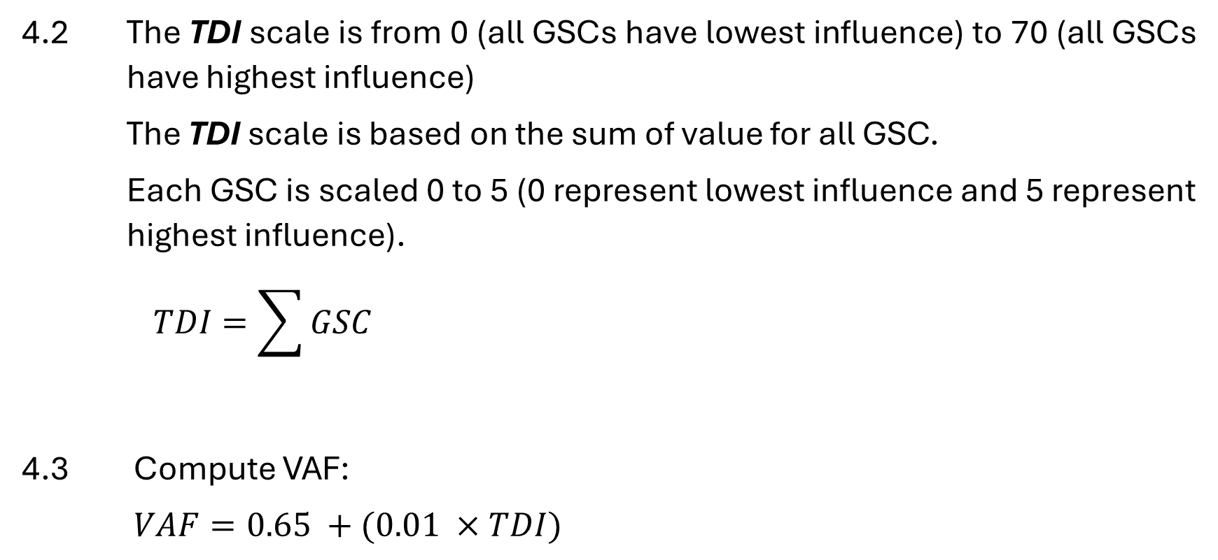

Slide 21
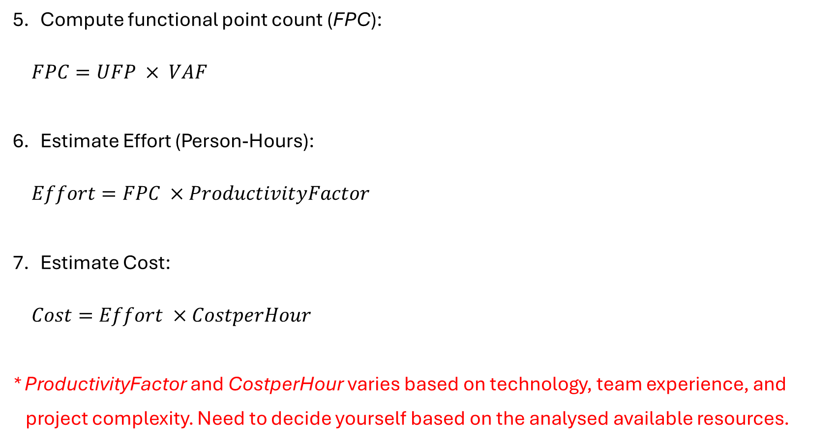

Slide 22
Example:
A company wants to develop a web-based eCommerce management system. Suppose the system to be developed has the following components:
Component | Count | Complexity | Weight
EI | 10 | Low | 3
EO | 5 | Average | 5
EQ | 8 | Low | 3
ILF | 4 | High | 15
EIF | 3 | Average | 7
Perform function point analysis (FPA) to calculate UFP, VAF, FPC, Effort and Cost.
Following information are provided:
  Total degree of influence (TDI) is 40 considering the project characteristics.
  Productivity factor is 15 person-hours.
  Cost per hour is $40 for each developer.

Slide 23
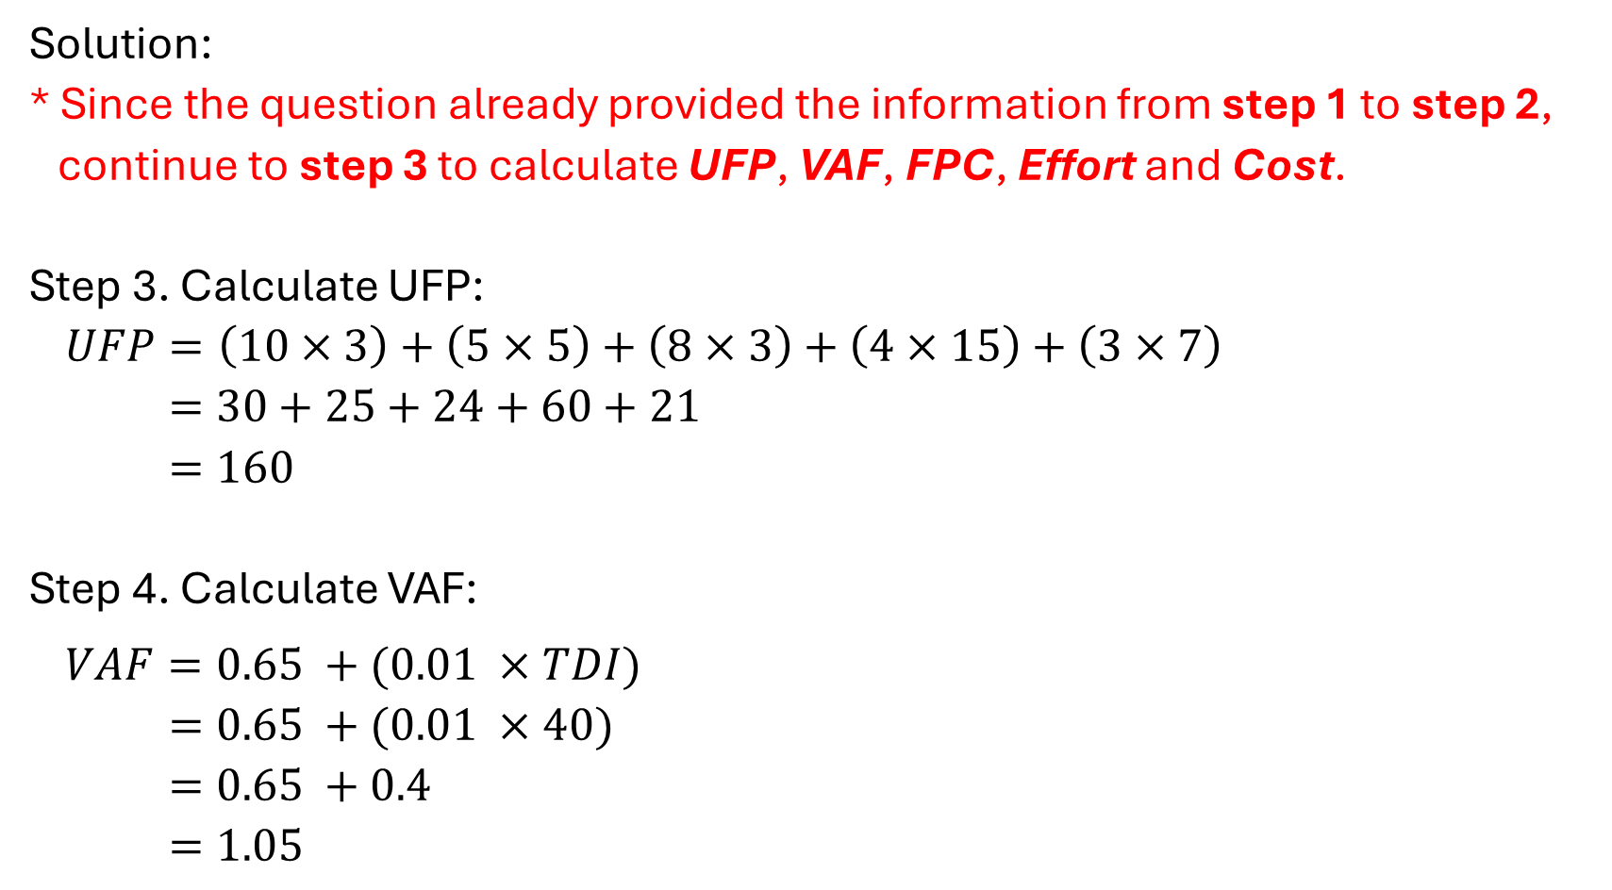

Slide 24
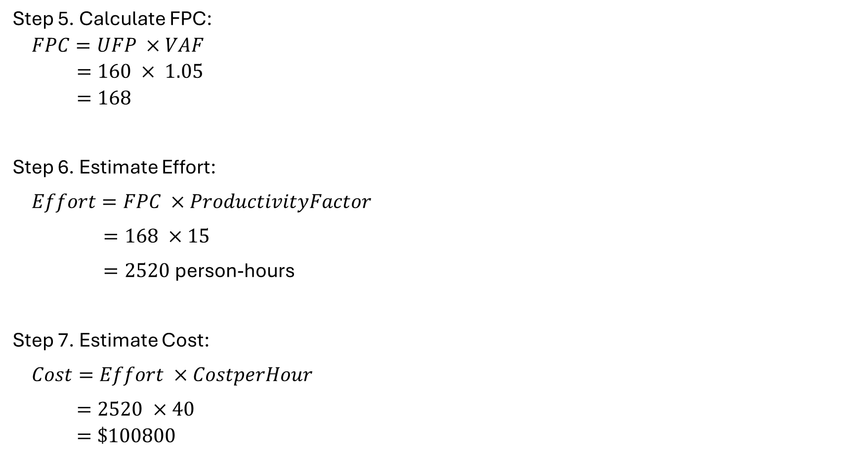

Slide 25
From the FPA result,
Function point count (FPC) for the project is 168.
Estimated effort needed to complete the project is 2520 person-hours.
Estimated cost to develop the software is $100800.

Slide 26
Estimation
A classical plan-driven or Waterfall project is usually based on somewhat of a contractual relationship between the business users and the project team.
An Agile project has a very different model. First, the requirements are typically not necessarily well-defined in detail upfront; and, in addition, change is the norm rather than the exception. Change is expected and encouraged as the project is in progress.

Slide 27
STORY POINTS AND VELOCITY
(Agile Estimation)

Slide 28
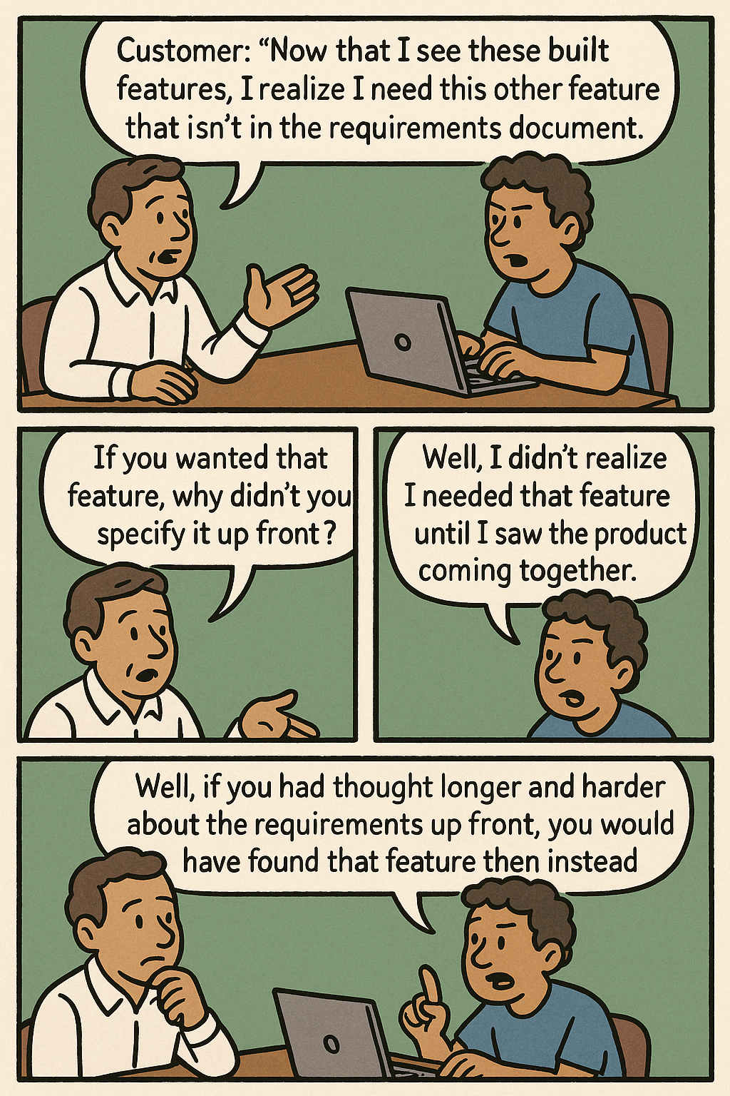
Why Agile Estimation?
The fact is, when developing innovative products, you can’t create complete requirements or designs up front by simply working longer and harder.
Some requirements and design will always emerge once product development is under way; no amount of comprehensive up-front work will prevent that.
Essential Scrum: A Practical Guide to the Most Popular Agile Process
(Addison-Wesley Signature Series (Cohn)

Slide 29
STORY POINTS
A story point is a metric commonly used for estimation in Agile projects.
It is a way of sizing the level of effort associated with a particular user story.
A story point is normally not directly tied to any specific measure of time; it is simply a relative measure of the level of difficulty of a particular story relative to other stories, and a story point may not have the same meaning among different Agile teams.
Story points combine factors like complexity and physical size into one relative size measure. The goal is to be able to compare stories and say things like “Well, if the create-a-ticket story is a 2, then the search-for-a-ticket story is an 8,” implying that the searching story is roughly four times the size of the creation story.

Slide 30
STORY POINTS
Other ways to estimate story points
  A Fibonacci sequence is often used for story point estimates because it provides an appropriate level of discrimination between large and small estimates without attempting to very accurately discriminate large estimates. A Fibonacci sequence is a series of numbers of the form of (1, 2, 3, 5, 8, 13, 21 — where each number is the sum of the previous two numbers).
  T-shirt sizes (Small, Medium, Large, XLarge, etc.) can also be used to create estimates.
Both story points and T-shirt sizes are designed to provide a very imprecise framework for making estimates that is appropriate to an Agile environment.

Slide 31
VELOCITY
Velocity is the amount of work completed each sprint.
Here is an example of how velocity can be used to develop an estimate for completing future work:
Assume that a team has completed an average of 60 story points of work per sprint over the past three sprints, and each sprint is two weeks long.
Suppose there is a total of 300 story points’ worth of work to be completed in the current release, and the Product Owner wants to estimate when the remainder of the release will be completed.
An estimate for completing the remaining in the release would be 300/60, or five sprints, and since each sprint is two weeks long, it will take approximately 10 weeks to complete the work.

Slide 32
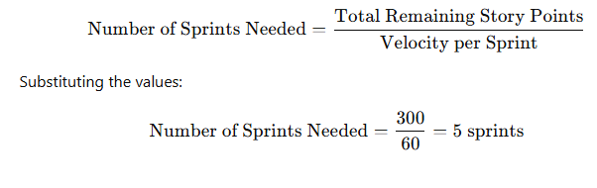
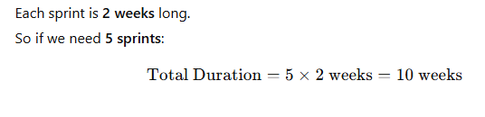
Velocity

Slide 33
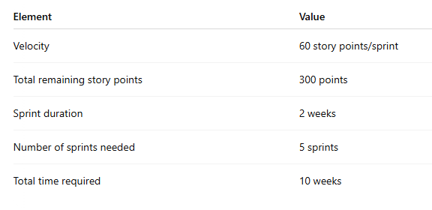
Velocity

Slide 34
SUMMARY
Accurate project size estimation is a critical aspect of software project management, as it directly impacts effort, cost, and scheduling.
The Function Point Analysis (FPA) method plays a significant role in software estimation by evaluating the functionality delivered to users, regardless of the underlying technology.
Agile estimation
A story point is a metric commonly used for estimation in Agile projects. It is a way of sizing the relative level of effort associated with a particular user story.
T-shirt sizes is another relative sizing technique.3.
Velocity estimate is based primarily on the velocity of the team

Slide 35
SUMMARY
While FPA enhances estimation accuracy and project planning, it requires expertise due to its reliance on subjective judgment and detailed analysis.
Incorporating effective effort, cost, and time estimation metrics ensures that projects are delivered efficiently, within budget, and meet quality expectations.

Slide 36
REFERENCES
Van Hai, V., Le Thi Kim Nhung, H., & Hoc, H. T. (2019). A review of software effort estimation by using functional points analysis. Computational Statistics and Mathematical Modeling Methods in Intelligent Systems: Proceedings of 3rd Computational Methods in Systems and Software 2019, Vol. 2 3, 408-422.
Keshta, I. M. (2017). Software cost estimation approaches: A survey. Journal of Software Engineering and Applications, 10(10), 824.
Cohn, M. (2005). Agile estimating and planning. Pearson Education.
McConnell, S. (2006). Software estimation: demystifying the black art. Microsoft press.
Van Vliet, H., Van Vliet, H., & Van Vliet, J. C. (2008). Software engineering: principles and practice (Vol. 13). Hoboken, NJ: John Wiley & Sons.

Slide 37


THANK YOU
utmofficial
univteknologimalaysia
utm.my

